Slide 1


Christmas
HOLIDAYS AND FESTIVALS

Slide 2

Draw a mind map and write down as many Christmas words as possible.
CAROLS
SANTA CLAUS
CHRISTMAS
SONGS

Slide 3
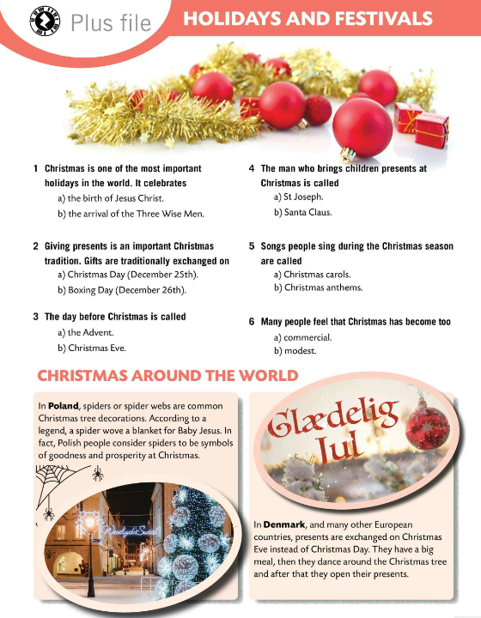
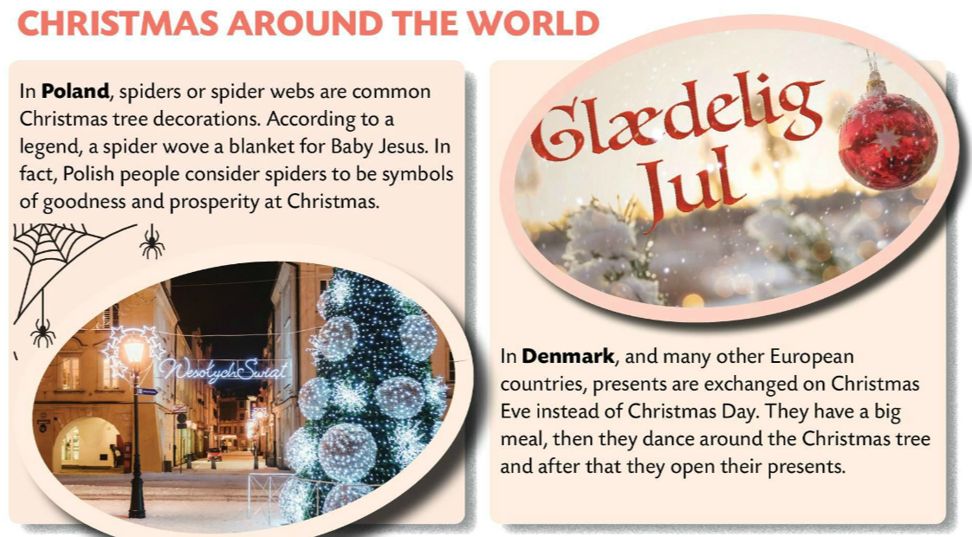
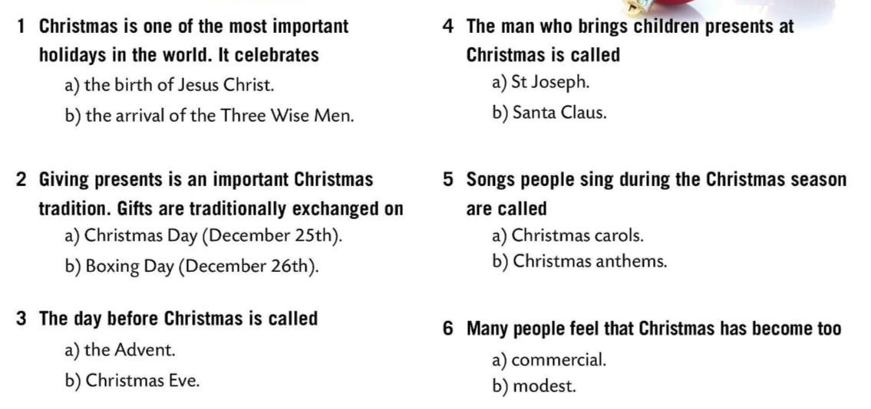
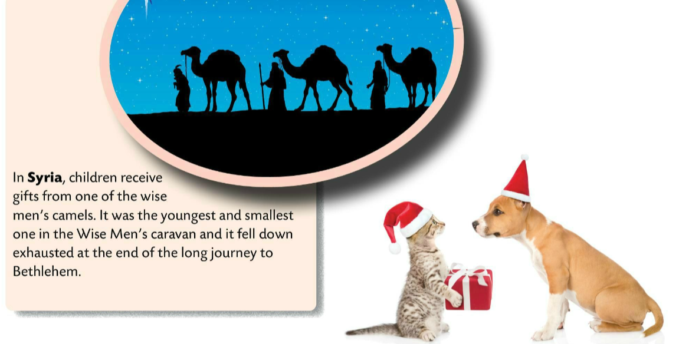
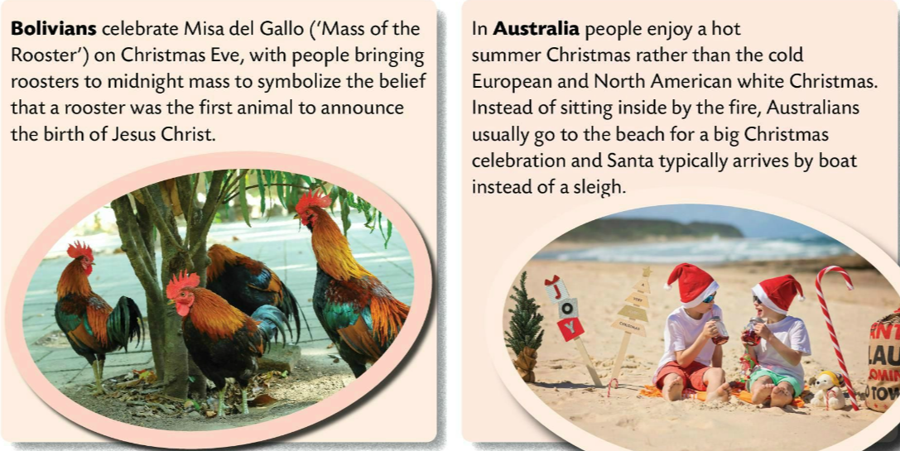
Read the questions and circle the correct answer.
Check.
Read the text and underline the new words.

Slide 4
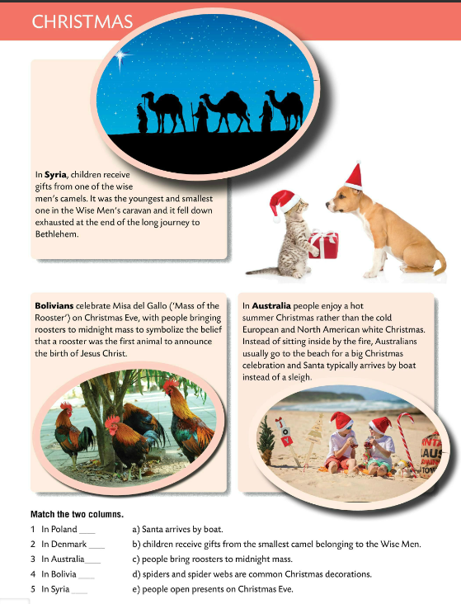
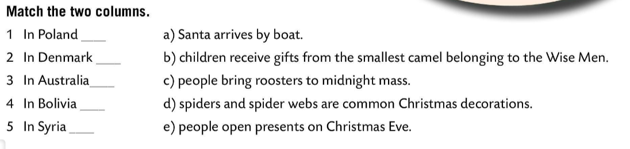
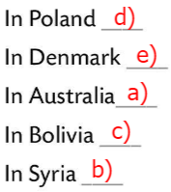
Read the text once again and match the two columns.
Check.
PROJECT TIME
Choose a country and do some research. Make a poster about the selected country and its Christmas traditions.

Slide 5
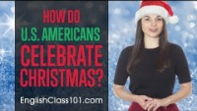
What do you think of American Christmas traditions and customs?
Which of the mentioned applies to your Christmas celebration?
Talk about Christmas traditions in your country.

Slide 6
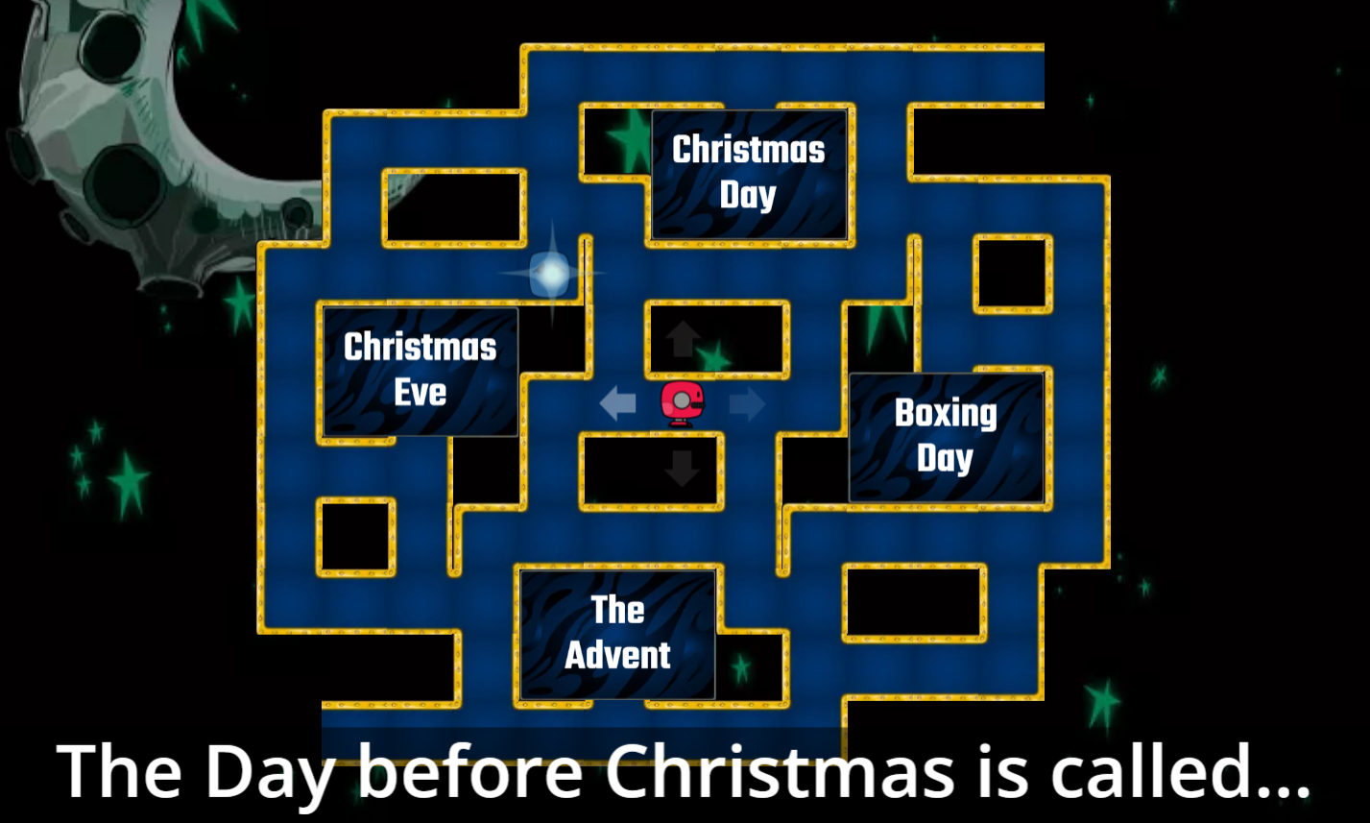
Let’s play a jolly Christmas game!
https://wordwall.net/play/856/178/917

Slide 7

Take this Christmas quiz.
1 The English put it on top of Christmas tree.
STAR
2 Jesus’s birthplace...
BETHLEHEM
3 He gives children presents for Christmas.
FATHER CHRISTMAS/SANTA CLAUS
4 Christmas songs…
CHRISTMAS CAROLS
5 Father Christmas says this to call your attention.
HO-HO-HO
6 The evening before Christmas…
CHRISTMAS EVE
7 It’s a bird that people traditionally eat at Christmas.
TURKEY
8 The four weeks before Christmas…
ADVENT
9 Holy Mary’s husband…
JOSEPH
10 A town in Galilee, where Jesus lived…
NAZARETH

Slide 8
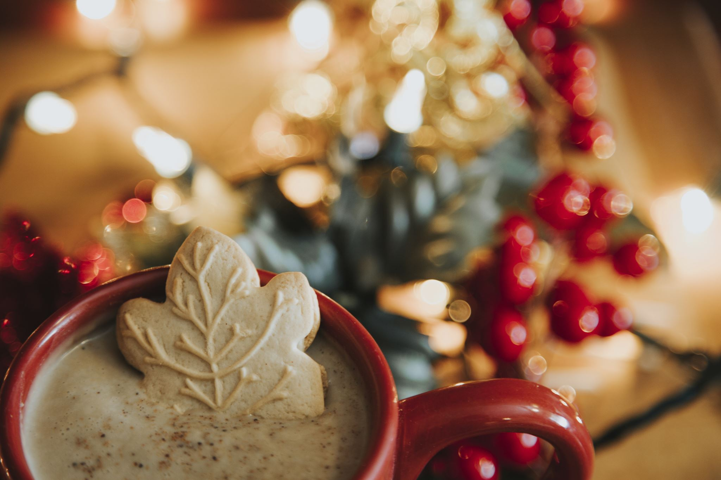
MERRY CHRISTMAS! ☺

